Slide 1

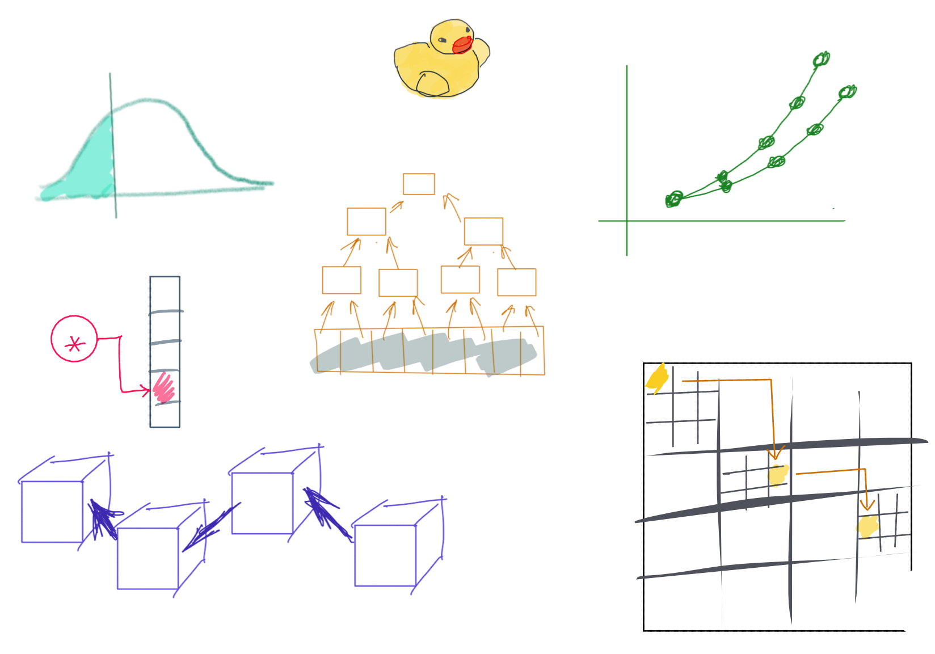

Slide 2
CSS342 Data Structures, Algorithms, and Discrete Mathematics (I)

Slide 3
The WHO

Slide 4

Lecturer
Peng Du
High performance computing
Matrix Factorization, etc
Cloud & Edge computing
Kubernetes, docker, etc.
Part-time Teaching
CSS 342 (2019)
CSS 143 (2020, 2021)

Slide 5


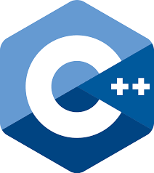


Lecturer
Day-job: Edge Computing
https://github.com/CentaurusInfra/fornax
Distributed Storage

Slide 6



Why “goose”?
Photography
https://www.instagram.com/fatgoooose
Working
https://github.com/a-teaching-goose
Racing
Comic design and drawing by @percima.art

Slide 7
The WHAT

Slide 8
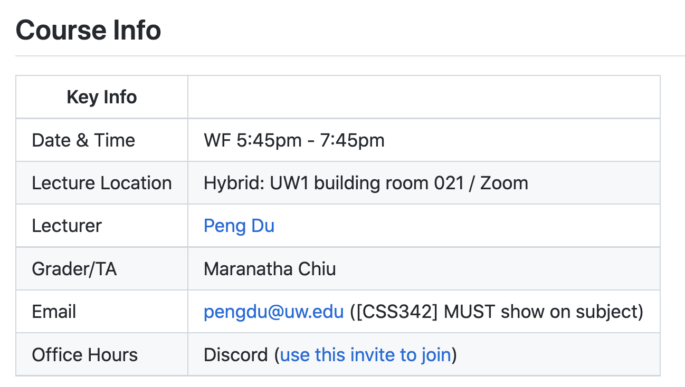
Class Info
Syllabus
https://github.com/a-teaching-goose/CSS342A-2022-Spring
You need to join our class github Team (private) to see this

Slide 9
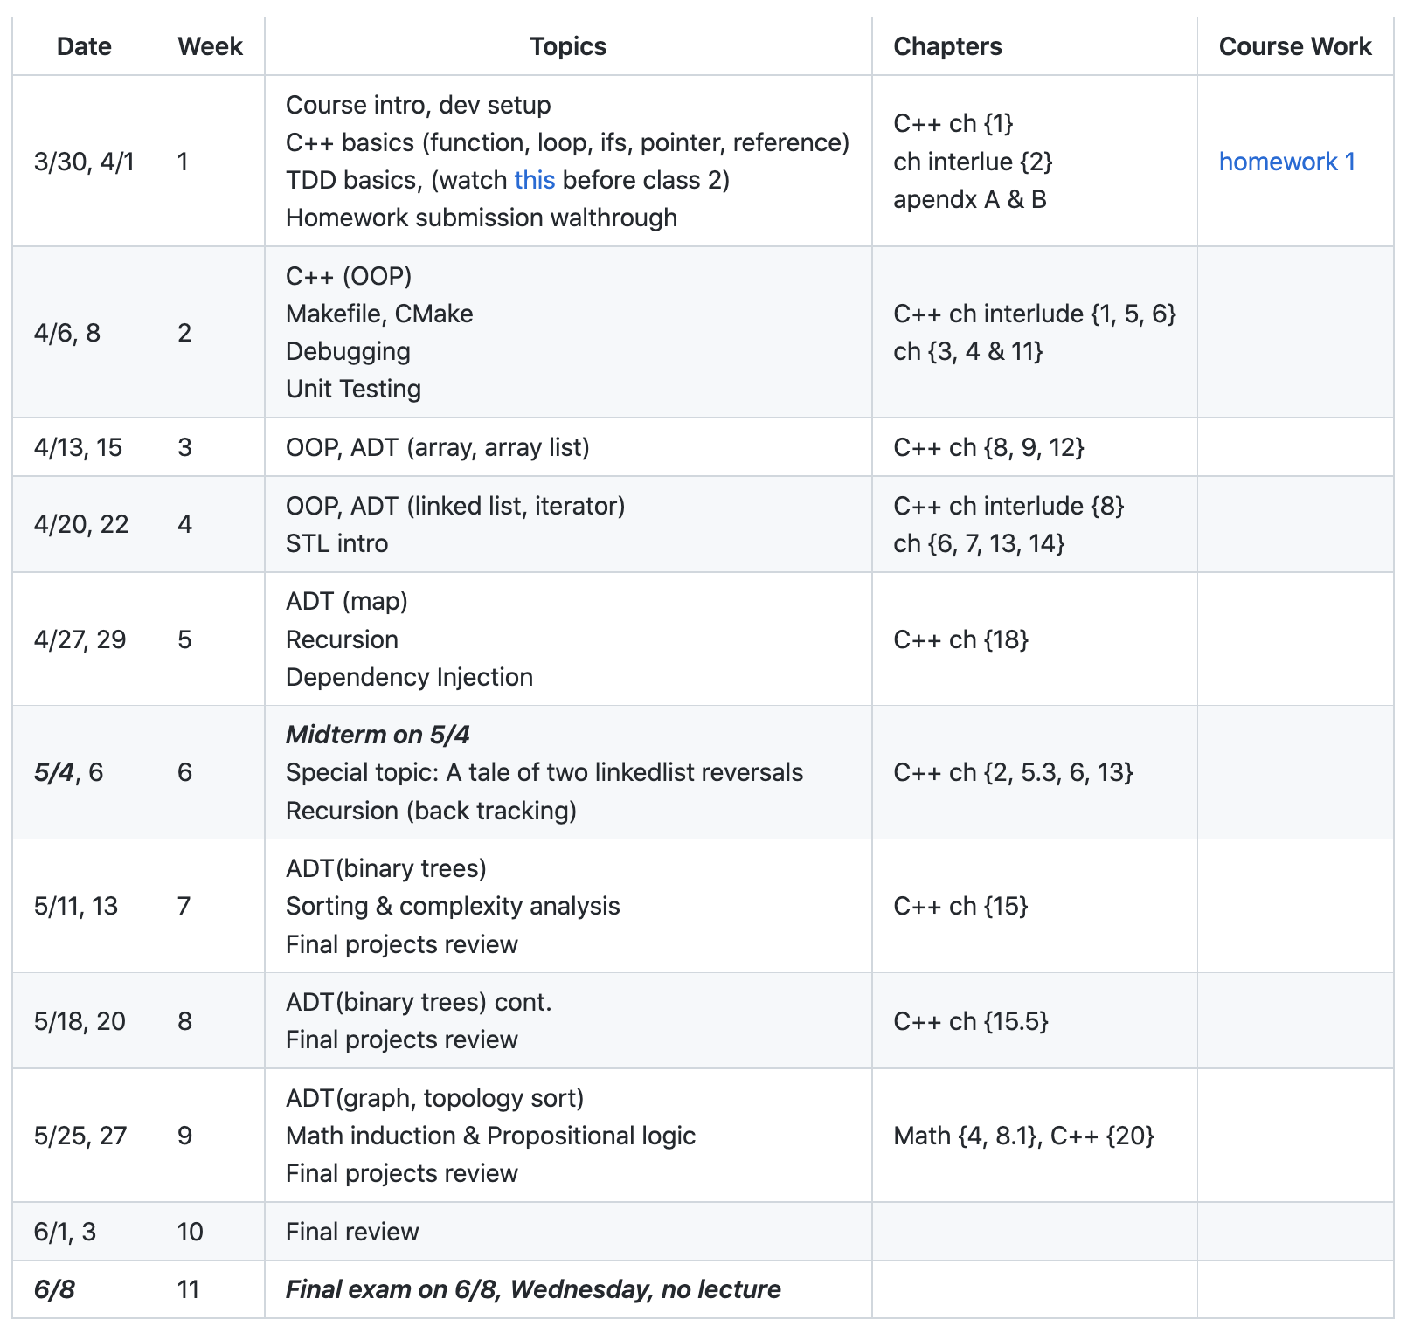
Class Info
subject to change
https://github.com/a-teaching-goose/CSS342A-2022-Spring#tentative-schedule
How do I know though?

Slide 10

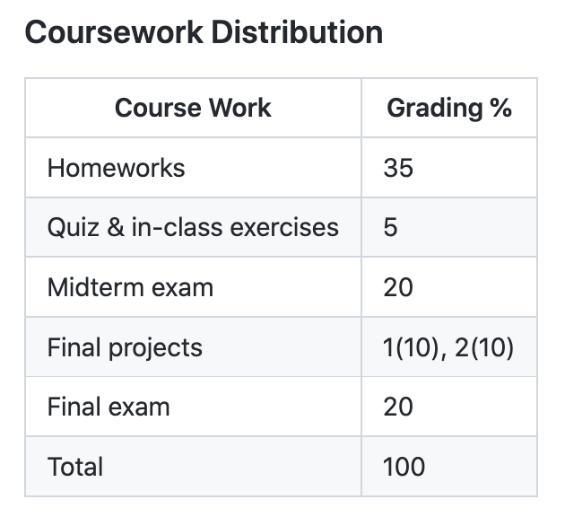
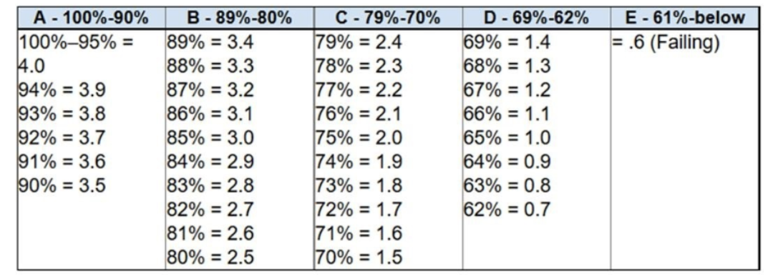
Grading
https://github.com/a-teaching-goose/CSS342A-2022-Spring#coursework-distribution

Slide 11
Expectation
What do you expect to learn from this class?
Data structure?
Algorithm?
C++
Anything else?

Slide 12
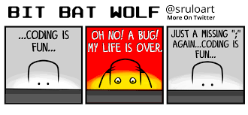
Class Expectation
After this term, you will
Be confident writing code in C++ with cool tools such as Clion, CMake, Makefile
Be confident with using source control tools Git and Github
Write clean code with solid tests
Have better understanding of data structure such as array, hashtable, list, tree
Understand how to compromise between time and space complexity
Have solved many technical problems commonly asked during interview
(hopefully) Write code and have fun

Slide 13
Expectation
This course will:
NOT focusing on teaching C++, but we will review the basics
Pointer & reference, class, template, OOP, etc.
NOT A math class, but we will touch some theoretical topics such as induction as formal proof

Slide 14
Homework, Tests, Exams
Weekly homework
15-min Quiz, mostly coding question
2 midterms (incremental, ~1.5 hr, close book)
1 Final (~2 hr, close book)
No late assignment will be accepted
Exception is very very rarely given
No make-up exam

Slide 15

Homework & Final projects

Slide 16
The HOW

Slide 17
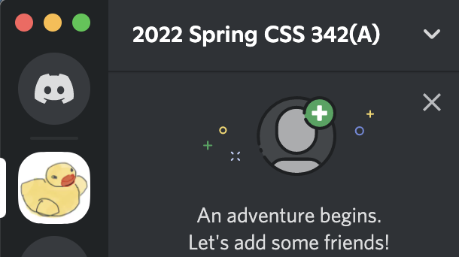
Why the “rubber duck”?
Think out LOUD
Talk to the Duck
https://rubberduckdebugging.com
https://www.youtube.com/watch?v=huOPVqztPdc

Slide 18

Code Along
Code together during class session
Instruction demo
Homework walkthrough
Have a ”read-to-go” dev environment ready
IDE, debugger, git/github
Volunteer to run a code-along session?

Slide 19
Schedule Ramping up
“I’ve forgotten what I learned in 142/143”
Week 1
(this week)
Week 2
Week 3
Week 4
C++
Dev env (IDE, Vim, debugging)
Source control (Git & Github)

Slide 20
Tips for Success
Good Sleep
Maintain good sleep
“Sleep” on it
Study Smart
Make small improvement everyday
Tracking progress (write log, blog, vlog…)
Practice, practice, practice (read/write code)
Communicate
If you have trouble with something, very likely you are not the only one
Ask the instructor (on Discord)
mistake, stuck → “opportunity to improve”

Slide 21

Plagiarism
Do the work yourself
It’s okay to get help from other people’s work/idea/code, but:
Give credit : “I was using […] for help in this homework”
Violation will be reported to department
School takes this VERY VERY seriously

Slide 22
Is it Plagiarism?
Case 1:
Stuck for 2 hours. Found an solution on stackoverflow.com. Copied answer into homework without changes and submit.
Plagiarism!!
Instead, understand the idea from the help source, and then write the code yourself. Better yet, make some improvement.

Slide 23
Is it Plagiarism?
Case 2:
Had discussion with friends, classmates, TA and/or instructor. Write code based on your understanding.
NOT Plagiarism!!

Slide 24
Is it Plagiarism?
Case 3:
Ask homework at paid-for-help service, someone there wrote the code, and you paste that code into submission
Plagiarism!!
Instead, understand the idea from the help source, and then write the code yourself. Better yet, make some improvement.

Slide 25
The Dev Environment

Slide 26
Tooling
OS:
Windows, Linux, Mac
IDE/Editor:
Visual studio, VS Code, Clion, Xcode, Atom, etc.
VIM, Emacs
Makefile, CMake
Online Editor
Testing:
A review by Clion
Googletest
Source Control
Git, www.github.com

Slide 27
Tooling
OS:
Windows, Linux, Mac
IDE/Editor:
Visual studio, VS Code, Clion, Xcode, Atom, etc.
VIM, Emacs
Makefile, CMake
Online Editor
Testing:
A review by Clion
Googletest
Source Control
Git, www.github.com

Slide 28
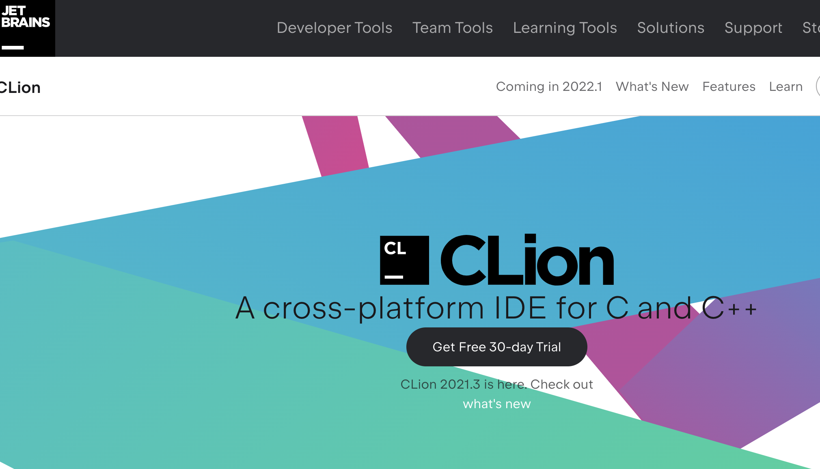
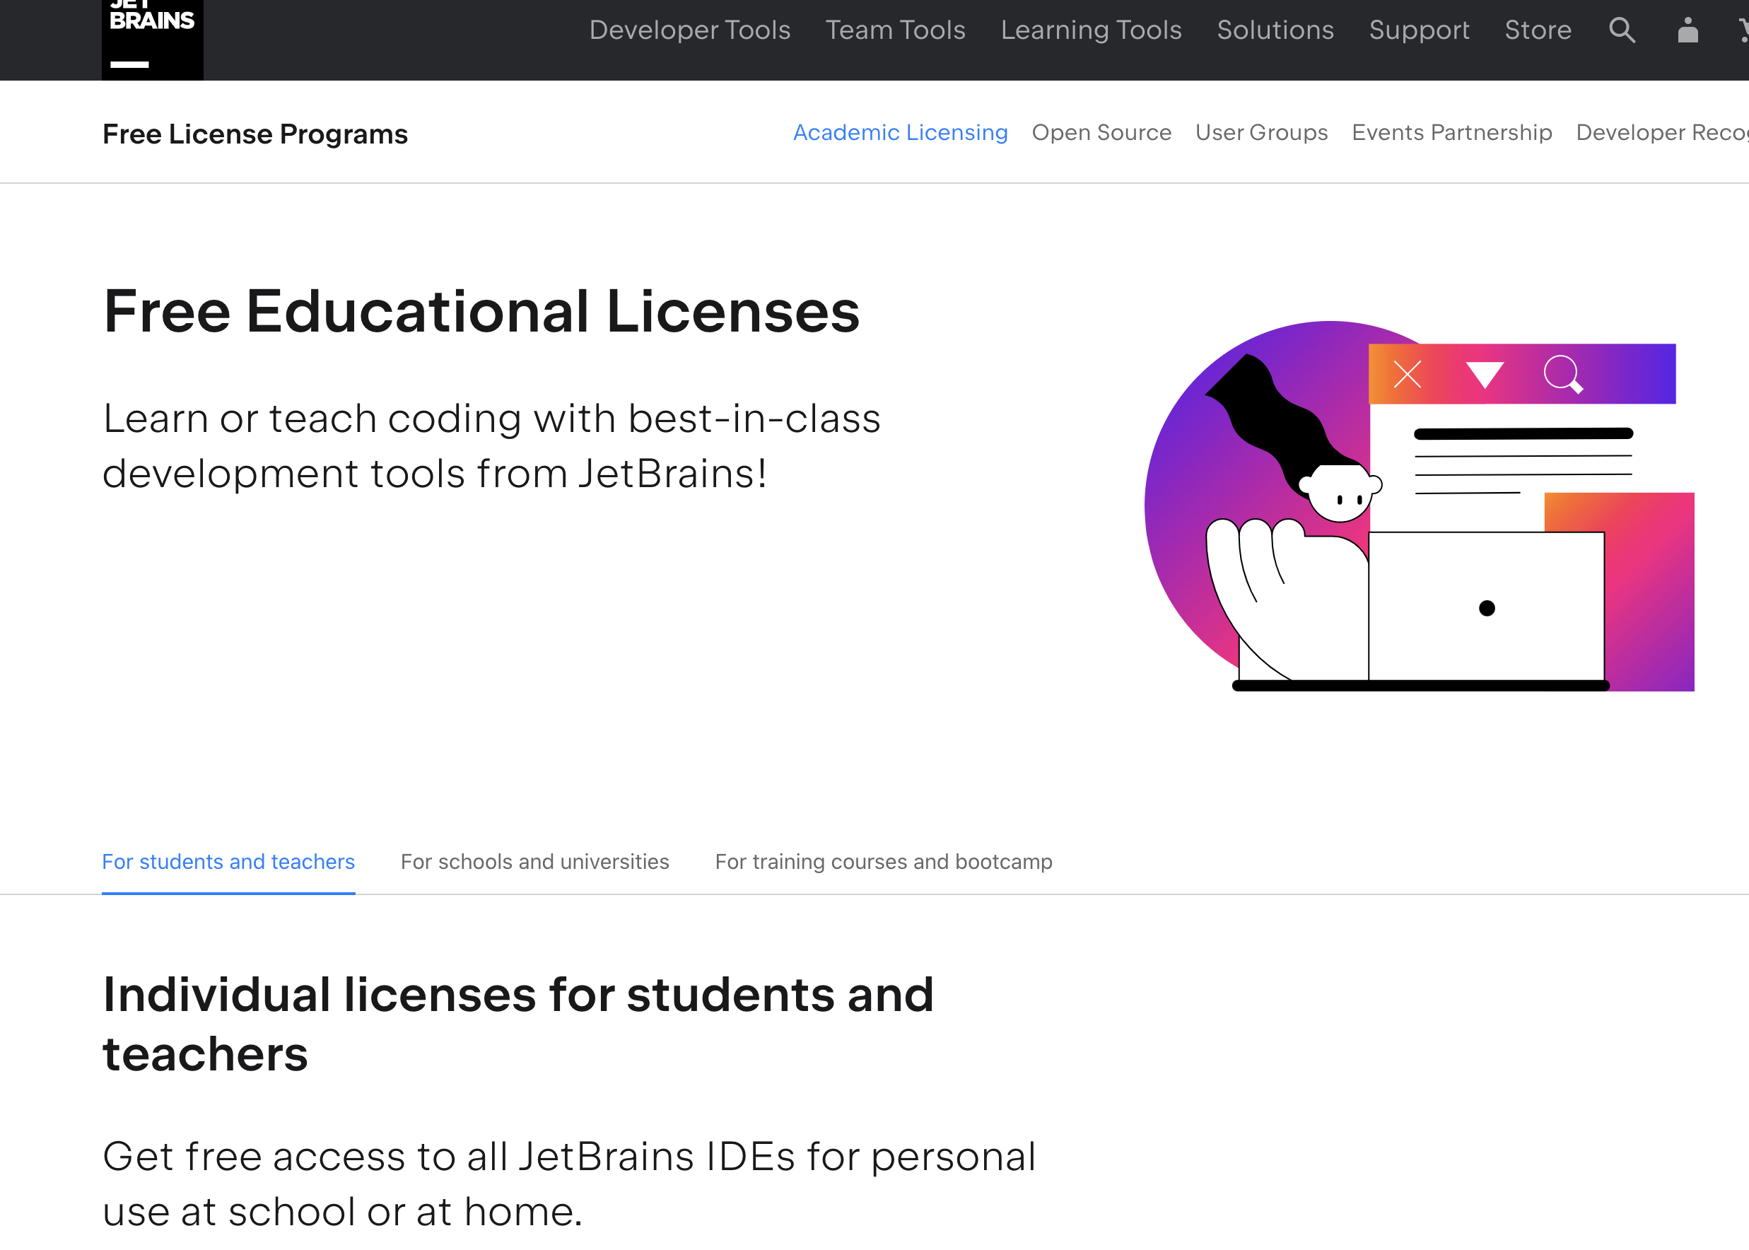
Editor: IDE
It’s Free!
https://www.jetbrains.com/clion/
https://www.jetbrains.com/community/education/#students
Demo!

Slide 29


Editor: IDE
But what about VS Code?
Won’t be used by instructor
You can still use it as long as submission test pass

Slide 30


Editor: Vim (Linux)
Available on (pretty much) all OS
Website in 80s, but probably the best editor you’ll have in your life
We use it to debug on Linux (only) if
Your submission has test failure, AND
That same failure doesn’t happen on your dev machine
Yes, you can choose to only use this for the course (optional)

Slide 31
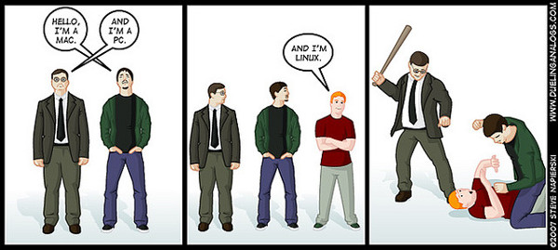
OS: Windows, OS, Linux
Normal coding
Either is fine (CLion)
Homework submission & grading
Linux, Ubuntu, 18.04, [defined here]
Available from Cloud Computing Platforms (e.g. AWS)
There will be demo this and next week on how to use this.

Slide 32

Programming Language: C++
“Learn as we go”
Basics:
Function
Loop
If-else
Primitive types
int, float
array
struct
Intermediate:
Template
Class
Pointer (new & delete)
Reference
STL containers
Advanced:
OOP
Smart pointers
Exception
File I/O
Makefile

Slide 33
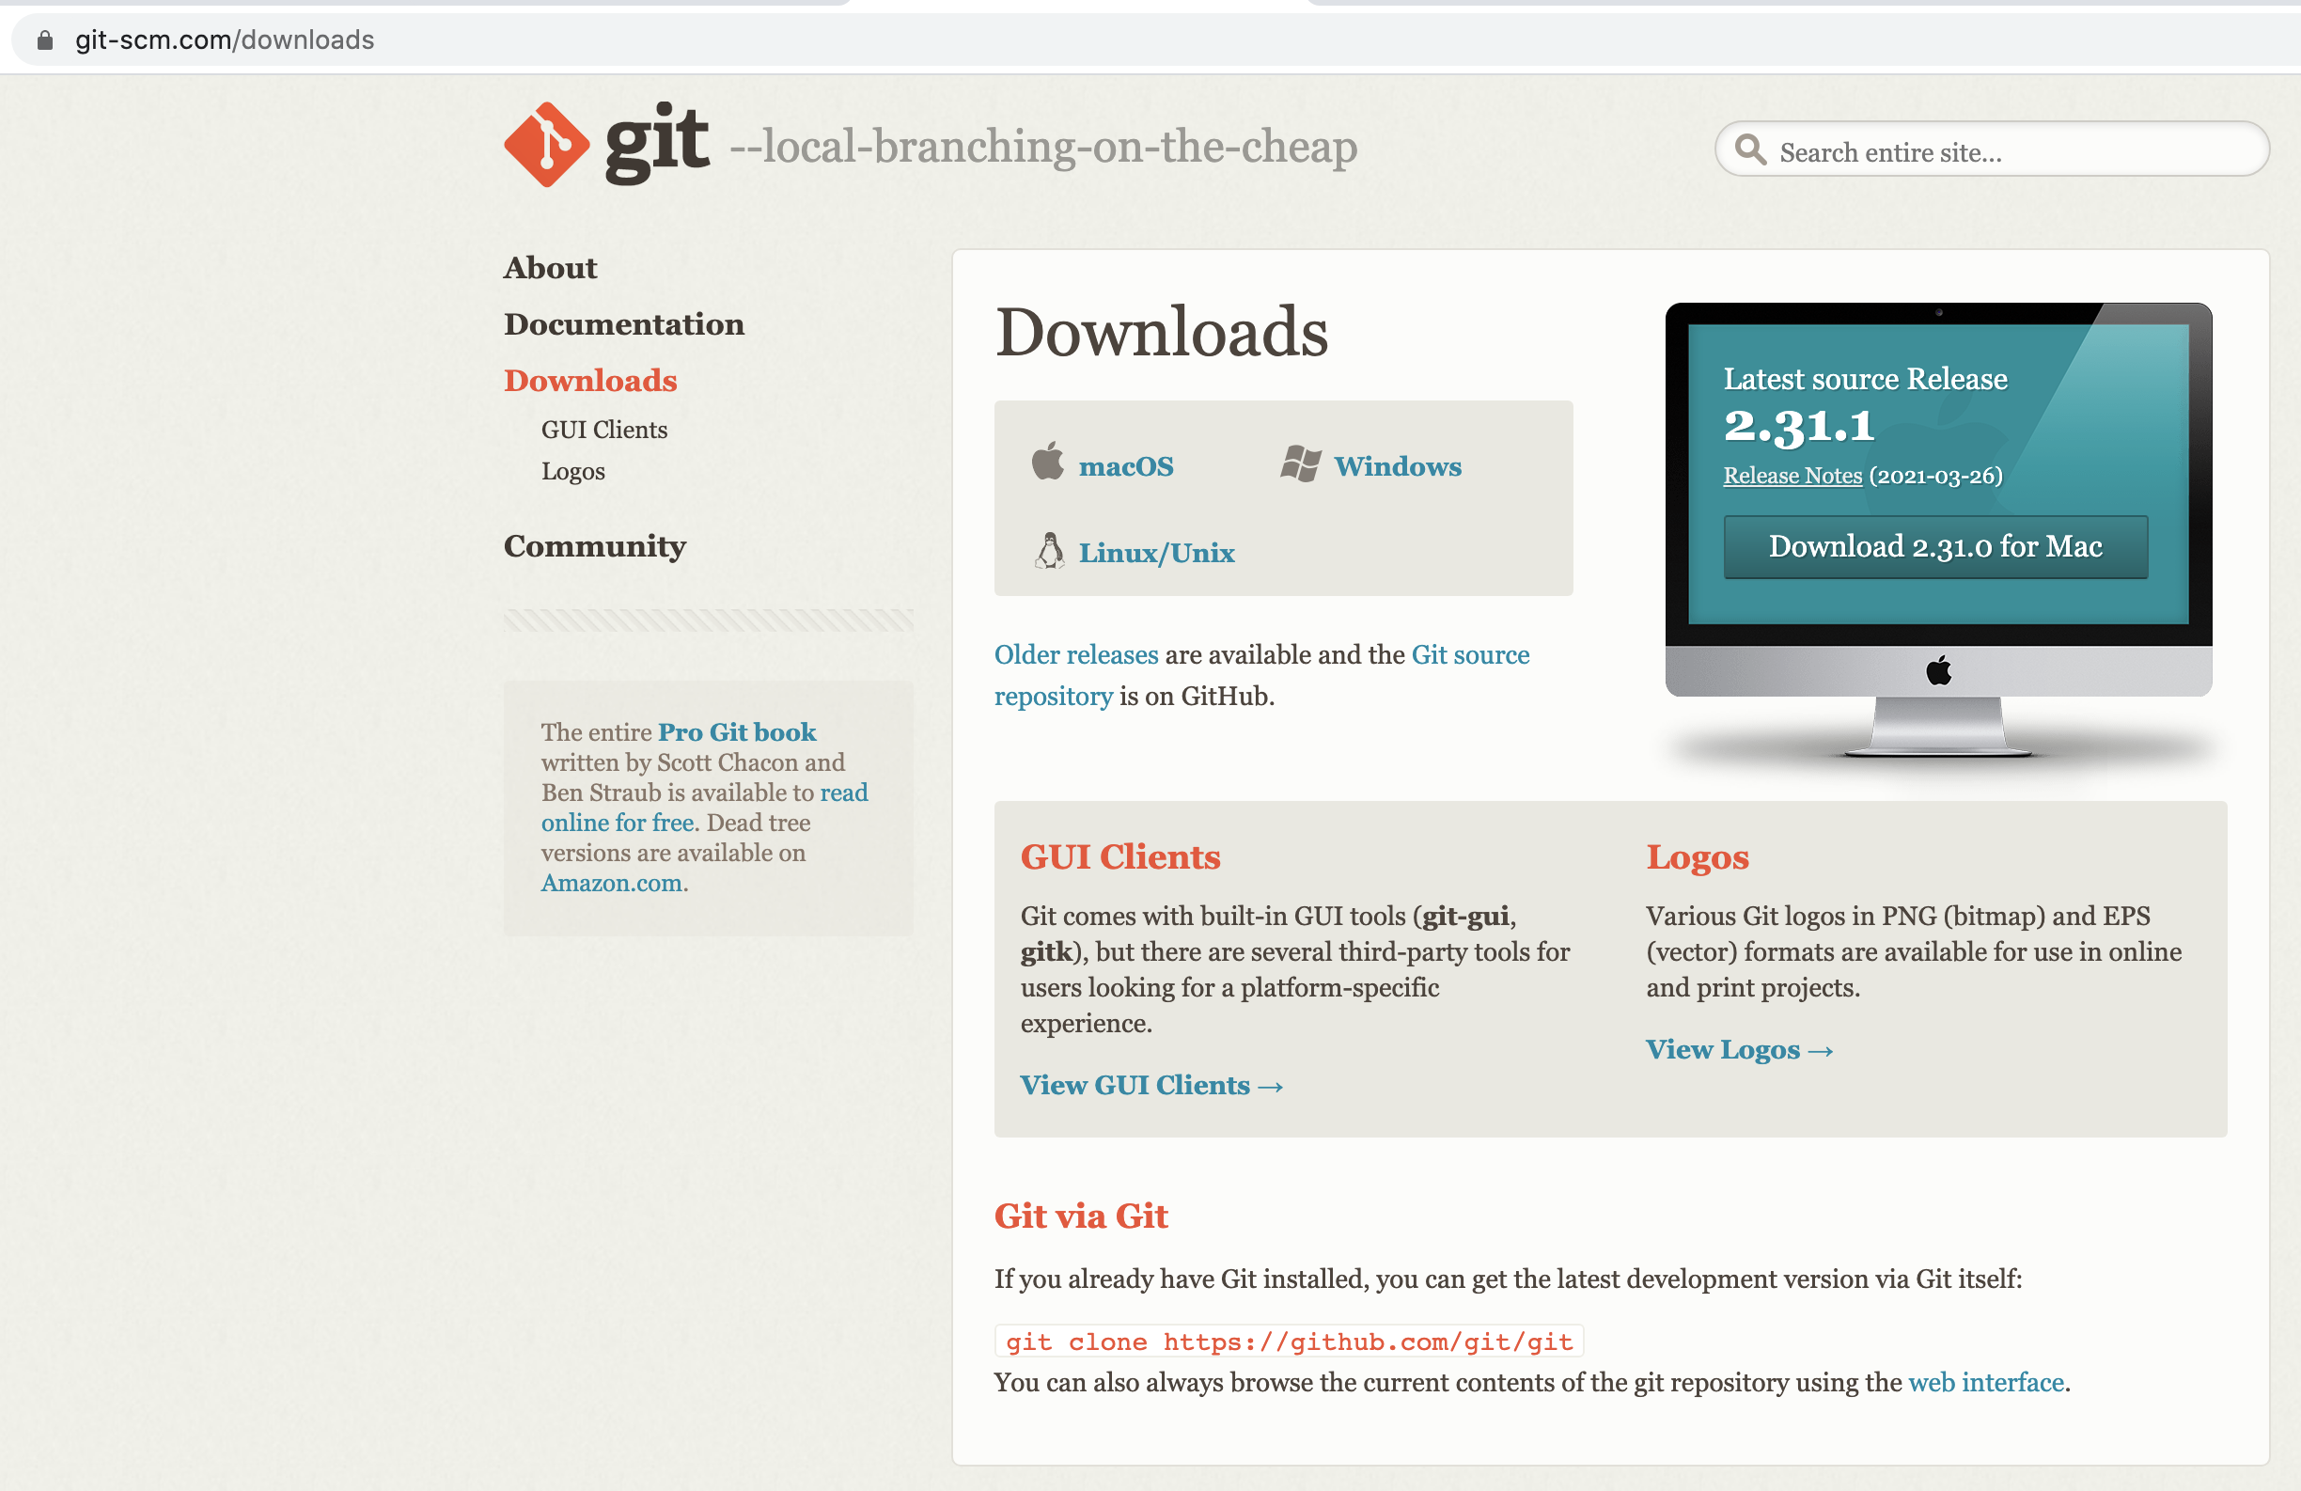
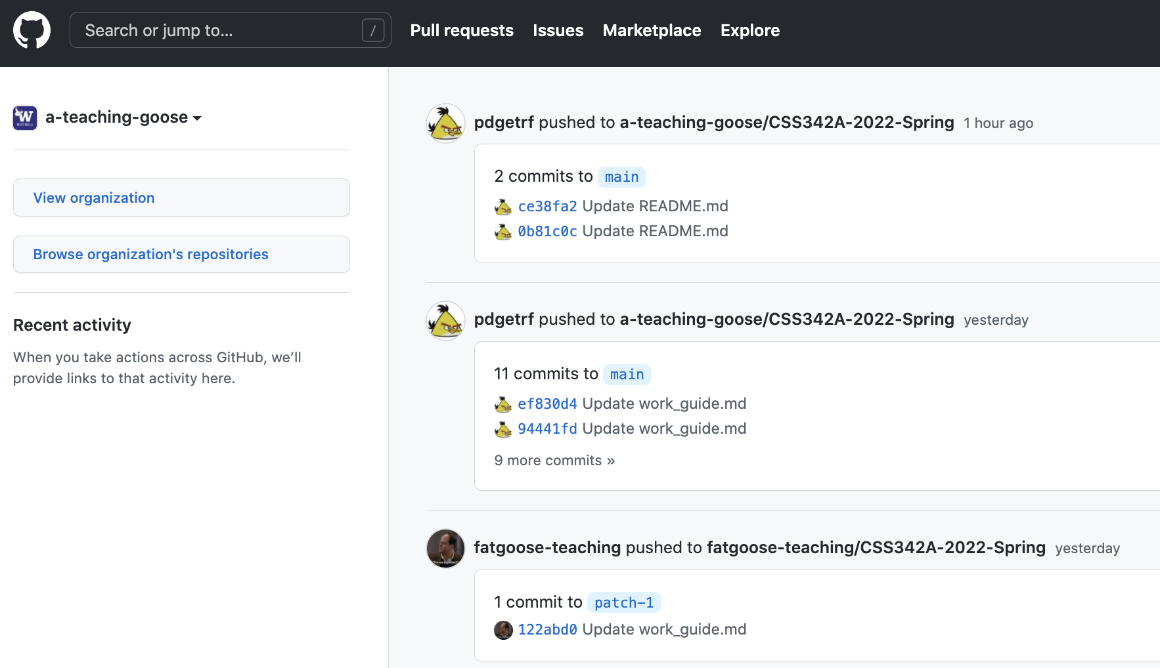
Git & Github
https://git-scm.com/downloads
https://github.com/

